Slide 1
Board Policies (BP) & Administrative Procedures (AP) Review Process
Step 6 - Board of Trustees *
BP -1st Reading AP - Information BP -2nd Reading Only
Step 5 - PFC
Review by PFC and recommendation made to the President before forwarding to Board. If changes are made, the AP or BP will return to PFC for consensus
Step 4 - President’s Council Administrative Council Review
All edits incorporated
Step 3 – VP/HR Review
Review/solicit feedback from SMEs (SS, Senate, Finance, HR).
Step 2 – President’s Review
Review and distribute to VPs/HR
Step 1 – CCLC/New
CCLC revisions update OR Constituent request for BP/AP

Slide 2
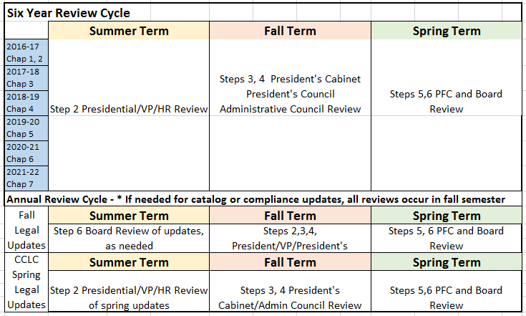
Review Cycle – Annual and Comprehensive Chapter Reviews Goal 1: Six Year Review Cycle of all policies and procedures - aligned with accreditation visits Goal 2: Annual Review of policies and procedures incorporating biannual legal updates issued by CCLC
Board Policies & Administrative Procedures Review Timeline
Planning Processes Updated – Accepted at PFC – 9/27/16

