Slide 1
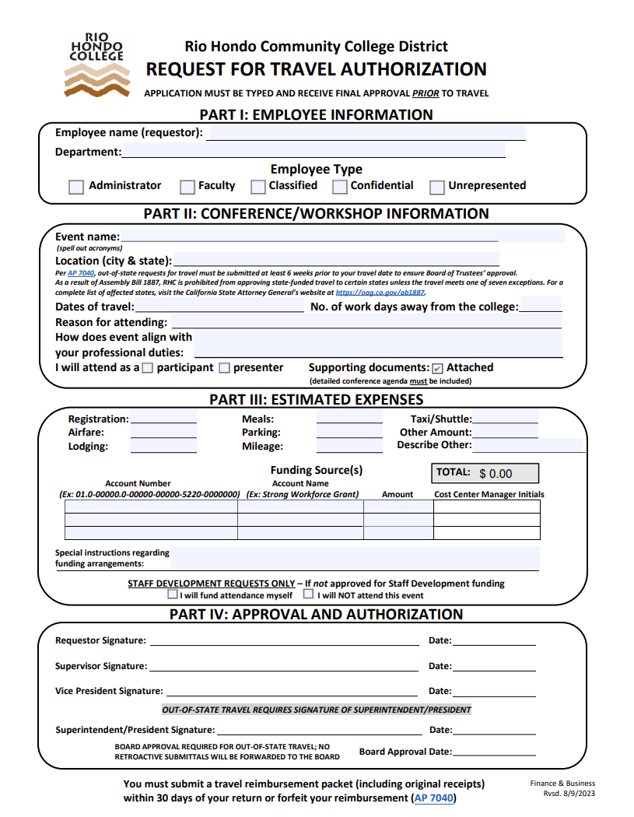
Filling out a Travel Authorization Request when awarded a Professional Development Grant
Please be aware that these instructions apply only to the Professional Development Office. Other departments may have different procedures so please check with the relevant department to understand their process. Thank you.
This is a fillable PDF form. Please complete all required fields, save the document with your changes, and ensure everything is finalized before sending it out for signatures using Adobe Sign.
Please note: All submissions must be typed. Handwritten paperwork will not be accepted.
*If you do not have access to this form, please contact your division or the Professional Development Office for a copy.

Slide 2
Filling out a Travel Authorization Request when
awarded a Professional Development Grant
Part 1 of the form: Please ensure all fields are filled out before moving on to the next step.
Your Name
Your Department
Please click on the option that applies to you

Slide 3
Filling out a Travel Authorization Request
when awarded a Professional Development Grant
Part 2 of the form: Please provide all information related to your conference and ensure that all fields are completed, as incomplete submissions may result in delays.
Please note: if you are traveling out of state, this form must be submitted at least 6 weeks prior to your travel date to allow time for Board of Trustees approval.
APPLICATION MUST BE TYPED AND RECEIVE FINAL APPROVAL PRIOR TO TRAVEL
A detailed conference agenda must be attached to your submission.

Slide 4
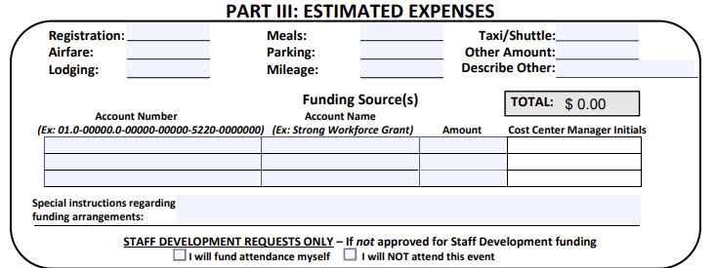
Filling out a Travel Authorization Request
when awarded a Professional Development Grant
Please research and estimate your expenses ahead of time as you will NOT be reimbursed for any expenses that exceed what is listed on this form. Additionally, per Accounting , if a section of the form is left blank, you are acknowledging that you will not request reimbursement for that item. Even if you have receipts, you cannot be reimbursed for anything not listed on your original, pre-approved Travel Authorization form. NO EXEPTIONS.
Make sure every expense you plan to be reimbursed for is fully filled out on your form. Mileage estimates are to be calculated from the RHC campus to the destination. As of 7/1/25, the reimbursement rate is .70 cents per mile.
Professional Development Administrative Assistant field
Professional Development Administrative Assistant field
Professional Development Administrative Assistant field
VP Tina Kuperman Field
When you route the form via Adobe Sign be sure to include the Professional Development Administrative Assistant, Brenda Moran and Cost Center Manager. V.P. Tina Kuperman so they can complete their portions.

Slide 5
Filling out a Travel Authorization Request
when awarded a Professional Development Grant
The form must be routed via Adobe Sign to your supervisor, your V.P., V.P. Tina Kuperman and Brenda Moran. If this involves out of state travel, the President must also be added. If you need assistance with Adobe Sign, please ask your Dean, Director, or office administrative assistant for help.
If your activity is out of state, all signatures are needed at least 6 weeks ahead of time to ensure pre-approval at a Board Meeting prior to travel.

Slide 6
Important Reminders about Professional Development Grant Reimbursement Process
All items below are needed by the Professional Development office to process reimbursement:
A copy of your completed Travel Authorization
Original receipts. No original receipts = no reimbursement.
A typed Professional Development Grant Report that includes an Invoice that does not exceed what you listed under expenses on your Travel Authorization. (form included in grant award email)
A typed Actual Expense form with amounts that do not exceed what you included under expenses on the Travel Authorization. (form included in grant award email)
You must submit all documentation within 30 days of your return.
Submissions received after 30 days will not be processed unless a typed explanation for the delay is submitted. Explanations are reviewed by the Director of Accounting. Only if approved by the Director can the process proceed.

